Slide 1
Using Blockchain in Privacy-Oriented Networking
Group 3:
Kevin Yomba, Legendre Cooper, Nathan Ketterlinus, Owen Segala, Preet Chodavadia

Slide 2
Abstract
Blockchain commonly known from cryptocurrencies
Is actually a distributed ledger
Every member in a network has a copy
Blockchain has a few critical attributes (like decentralization)
We will identify 7 shortly
Powerful implications in networking
We examine potential blockchain applications
In the Internet of Things (IoT)
In vehicle-to-vehicle communication (V2V)
We generalize these applications to networking holistically.

Slide 3
Introduction
Contemporary issues in networking:
Data Integrity
Privacy Preservation
User Authentication
Novel solutions found with Blockchain!
Minimal overhead with correct implementation
Real-time communication viable

Slide 4
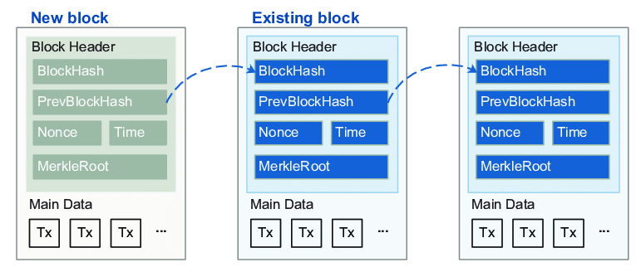
Background - What is a Blockchain?
Network-wide ledger of transactions (Tx)
Records every Tx between network users
P2P network Validates every Tx
Appends Tx to head of blockchain (like a linked list!)
Distributes updated ledger to all users
Validation through a consensus mechanism
Proof-of-Work
Proof-of-Stake
Many others!
Fig. 1. Illustration of a chain of blocks [1].
3 classes of blockchain:
Public (typically used; what we focus on)
Private
Consortium

Slide 5
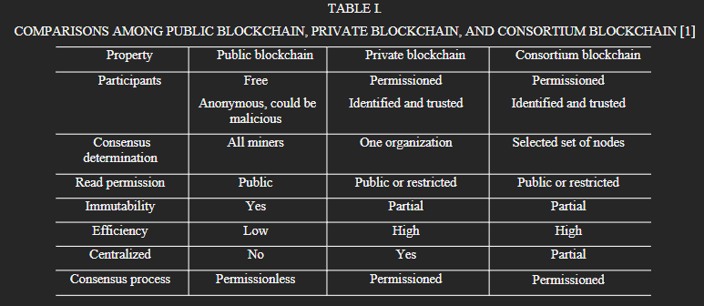
Background - What is a Blockchain?

Slide 6
Background - Blockchain Advantages
1. Decentralization: Tx records are stored in a P2P network. With no central controller, there’s no bottleneck on the network from it.
3. Transparency: Every node has access to the blockchain’s complete ledger. Gives blockchain credibility as an accurate source of current transactions.
5. Immutability: All blocks are immutable unless one person controls >50% of voters. As networks get larger, attacks quickly become infeasible.
7. Security: Each Tx is broadcast, checked, validated, & linked by nodes across the network. Tampering is easily detected, & thus strongly discouraged.
2. Auditability: All members can search Tx history with Tx timestamps. Useful when proofreading a blockchain for tampering & following resources.
4. Autonomy: Each node sends & receives transactions independently through consensus mechanisms & public/private key pairs. No need for human interaction or third-party auditors. Also prevents conflicting or double records in the blockchain.
6. Pseudonymity: Users are given a pseudonym address to avoid identity exposure. Allows blockchain to be used in spaces that demand high privacy.

Slide 7
Applications in IoT
Data Integrity and Authentication
Decentralization -> no single point of failure in IoT networks
Immutability -> reduces risk of cyberattacks on IoT devices [2]
No replay or man-in-the-middle attacks!
Data Collection and Exchange
The BSDCE-IoV model allows secure communication via encryption before transmission [3]
Anonymized device identities preserves privacy even in public scenarios [3]
Integration of Edge Computing
Reduced latency
Increased transaction throughput

Slide 8
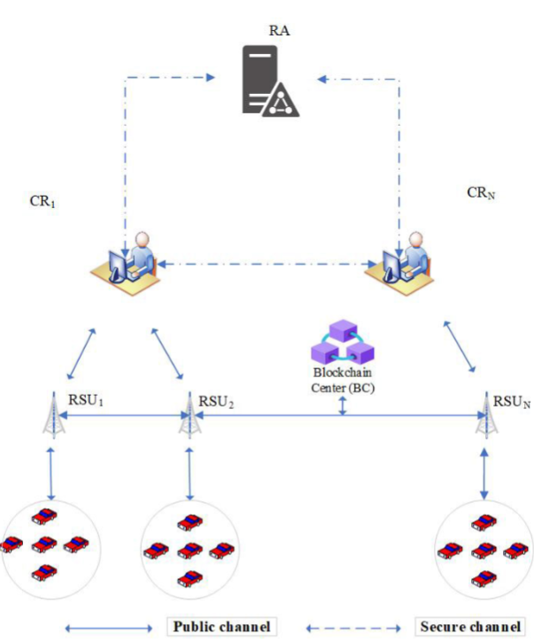
Applications in Vehicular Networks - V2V Comm.
Traditional issues:
Users rapidly join and leave network
Logically dividing networks
Real Time Communication
Proposed solution in [3]:
Private blockchain
Cars connect to Road Side Units (RSUs) along route
RSUs communicate with Control Rooms (CRs) and a central Registration Authority (RA)
RA preserves data integrity & user privacy
Fig. 2. IoV component registration [3].

Slide 9
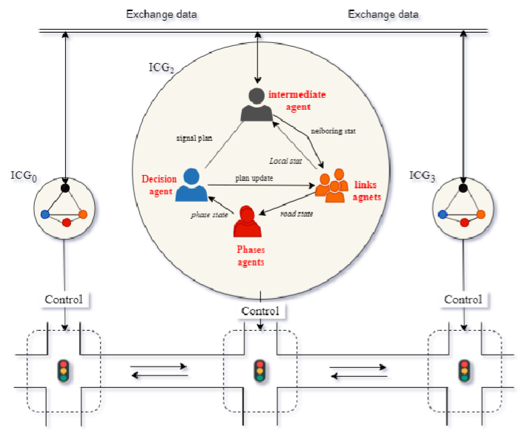
Applications in Vehicular Networks - Blockchain Intersections
Smart intersections allow for:
Shorter commutes
Fewer accidents
Blockchain intersection proposed in [4]:
Improved data security
Comparable performance
Intersections consult blockchain to gather state of neighbors
Intersection Control Group (ICG) determines how to update itself
Fig. 3. Overview of distributed-control intersection network [4].

Slide 10
Discussion
Decentralization removes the single point of failure of centralized designs
Transparency, immutability, and auditability provide resilience against cyber attacks like:
Replay attacks
Man-in-the-Middle attacks
Sybil Attacks
And more!
Security and pseudonymity preserves data privacy, even in public scenarios
These strengths can be leveraged in many general networking problems
Poises blockchain as a viable option in the future

Slide 11
Conclusion
We have discussed the strengths of blockchain’s design
We have covered specific case studies of the blockchain in action
The biggest takeaway is that blockchain’s use in networking is generalizable
Serves as a communication paradigm for the privacy-concerned
Preserves data integrity by removing third-party auditors
Redundancy in data storage enables auditability and disallows tampering
Blockchain has many uses in the future of networking!

Slide 12
References
[1] Y. Liu, F. R. Yu, X. Li, H. Ji, and V. C. Leung, “Blockchain and machine learning for communications and Networking Systems,” IEEE Communications Surveys &amp; Tutorials, vol. 22, no. 2, pp. 1392–1431, 2020. doi:10.1109/comst.2020.2975911
[2] S. M. Karim, A. Habbal, S. A. Chaudhry, and A. Irshad, “BSDCE-Iov: Blockchain-based Secure Data Collection and Exchange Scheme for Iov in 5G environment,” IEEE Access, vol. 11, pp. 36158–36175, 2023. doi:10.1109/access.2023.3265959
[3] B. Liu, X. L. Yu, S. Chen, X. Xu, and L. Zhu, “Blockchain based Data Integrity Service Framework for IOT data,” 2017 IEEE International Conference on Web Services (ICWS), Jun. 2017. doi:10.1109/icws.2017.54
[4] M. E. Ghazouani et al., “A blockchain-based method ensuring integrity of shared data in a distributed-control intersection network,” International Journal of Advanced Computer Science and Applications, vol. 14, no. 10, 2023. doi:10.14569/ijacsa.2023.014105

